Slide 1
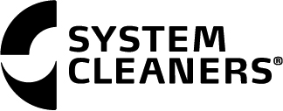
Advances in Automation

Slide 2
PROFIT.
It’s not a bad thing…

Slide 3
Defining what automation is
“Automation is the use of machines, control systems and information technologies to optimize productivity in the production of goods and delivery services…

Slide 4
Why implement automation
“…the correct incentive for applying automation is to increase productivity, and/or quality beyond that possible with current human labor levels so as to realize economies of scale, and/or realize predictable quality levels…

Slide 5
What usually happens-
…The incorrect application of automation, which occurs most often, is an effort to eliminate or replace human labor”
-Wikipedia

Slide 6
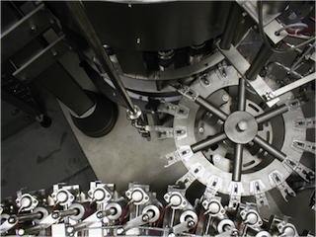
Benefits of automation
Mitigate Risk
Capture uptime
Repeatability
Sustainability

Slide 7
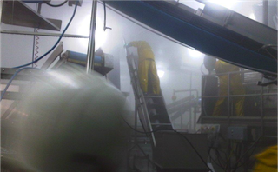
Mitigate Risk

Slide 8
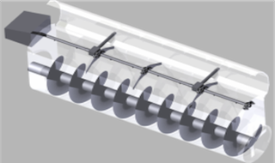
Typically, in plant sanitation, what can go wrong at some point will go wrong.

Slide 9
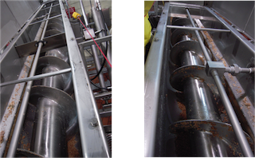
Pre - Rinse

Slide 10
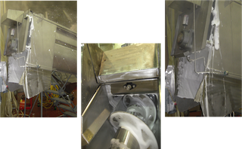
Foam

Slide 11
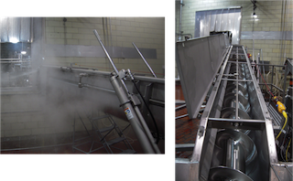
Final rinse and inspection

Slide 12
Capturing additional uptime
Example:
Filler in salad dressing plant
Reduction in product change over from 15 minutes to less than one minute
Complete sanitation tear down from once every 5 days to once every 9 days.

Slide 13

One minute product change…

Slide 14
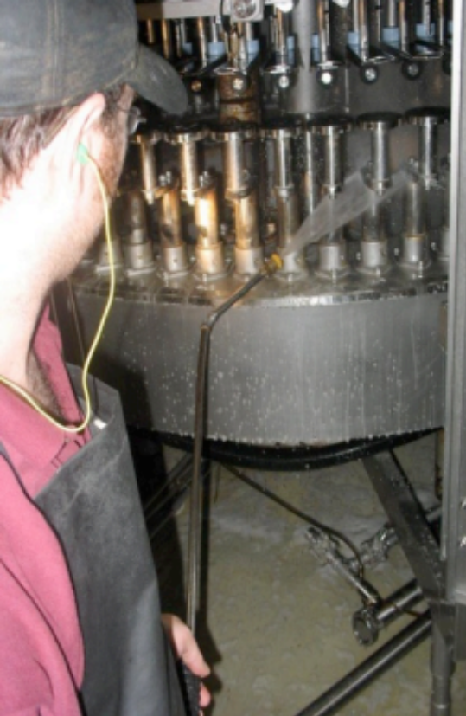
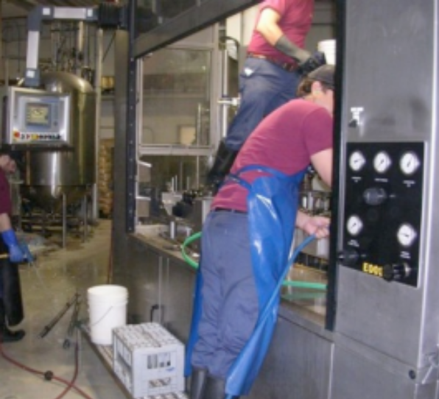
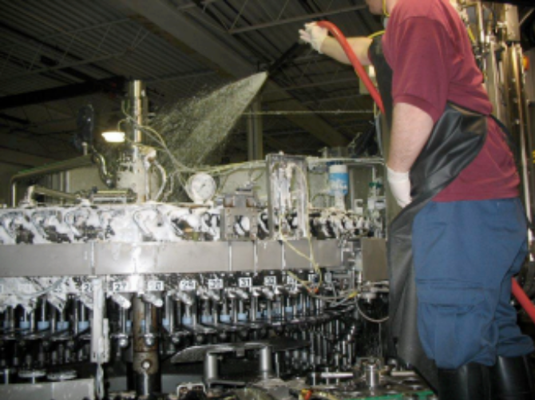
Capturing additional uptime
Manual Cleaning in Brewery

Slide 15
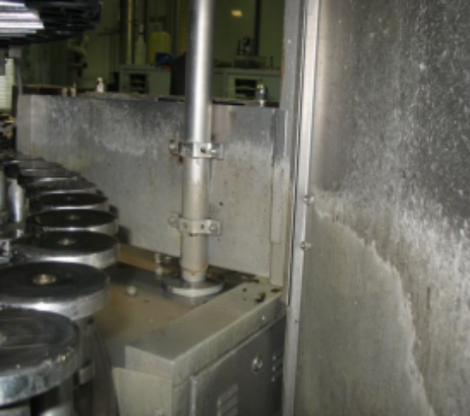
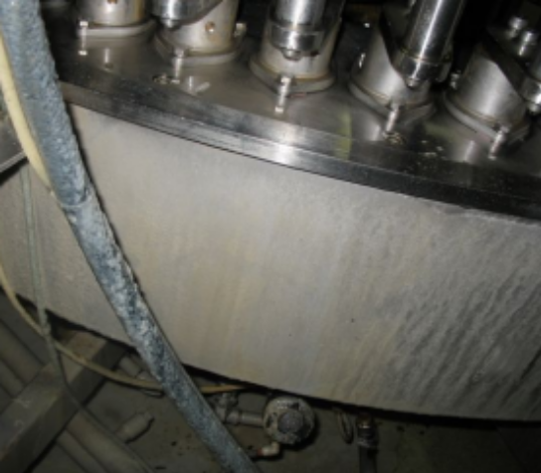
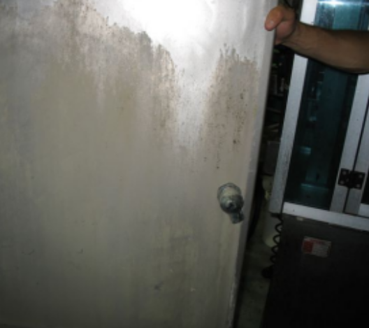
Capturing additional uptime
Daily clean was 2.5 to 3 hours per day
Weekly clean 6 hours
Production demands made it increasingly difficult to provide sufficient clean time

Slide 16
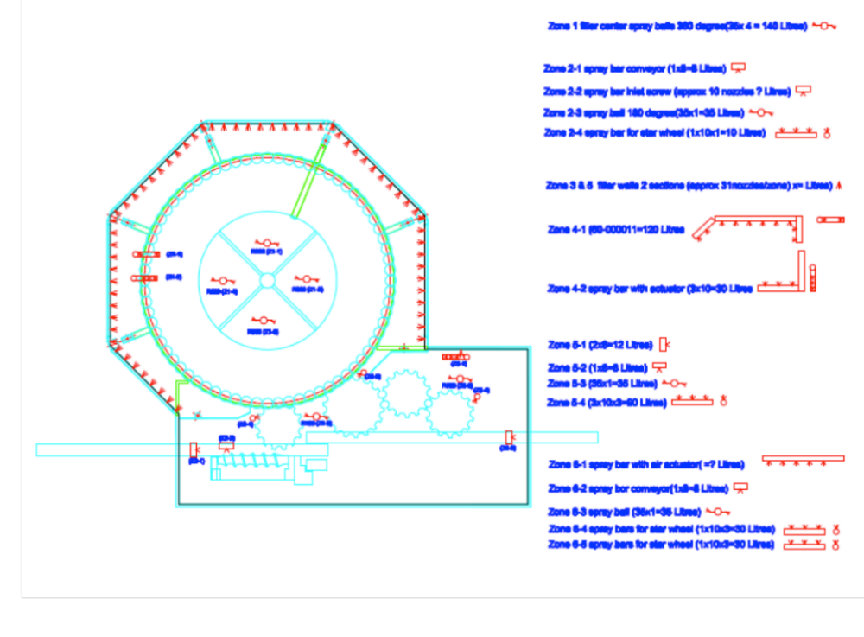
Capturing additional uptime
The full 6 hour cleaning process now completed in exactly 35 minutes

Slide 17


Slide 18
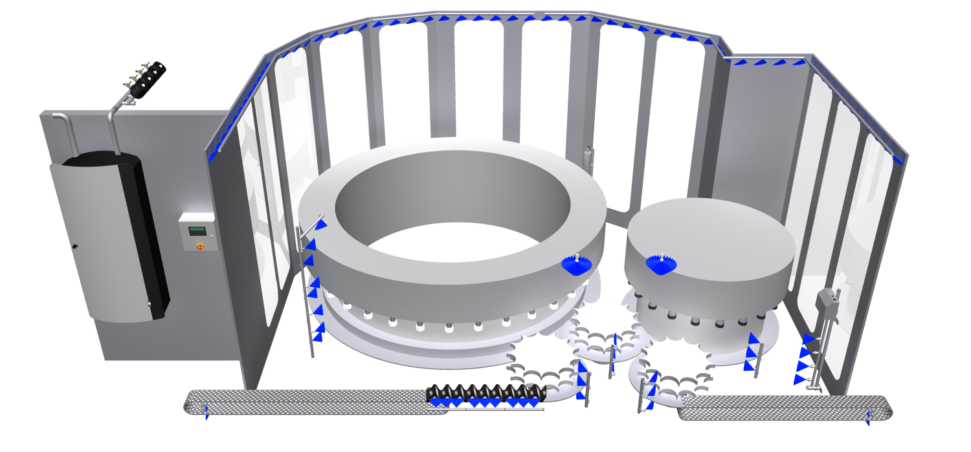
Segment valves
PLC
Automatic
Main station
with VFD motor

Slide 19
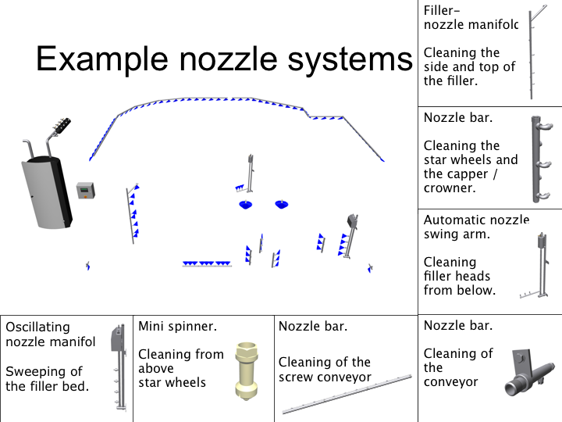

Slide 20
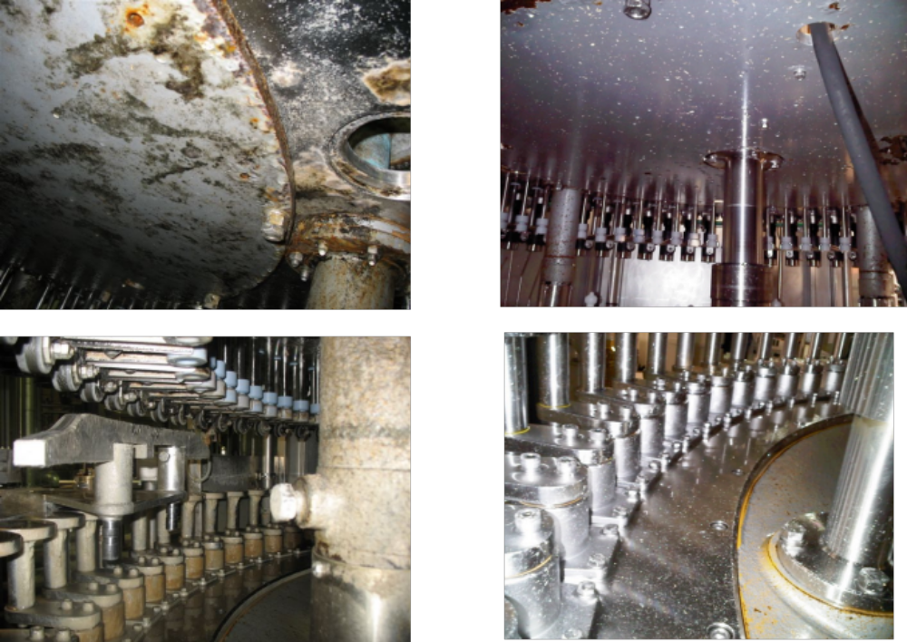
Upper photos: Lower side of mounting system
Lower photos: Filling turret container platform carriers
Before
After

Slide 21
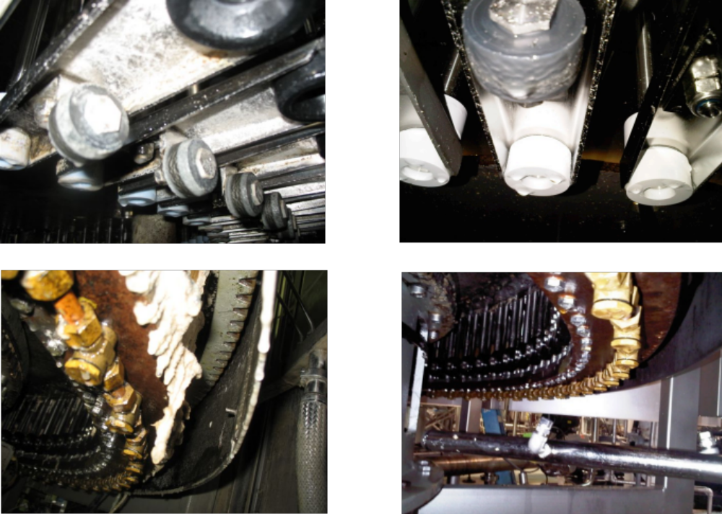
Upper photos: Container platform carrier
Lower photos: Underside of filling turret
Before
After

Slide 22
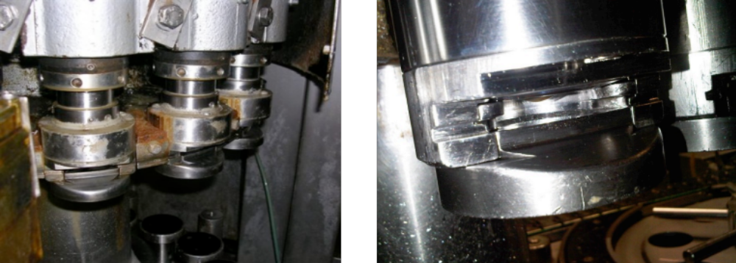
Filling nozzles – before and after

Slide 23
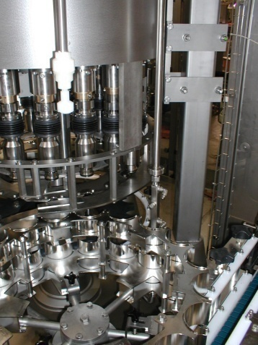
Repeatability
Proper water pressure creates fewer aerosols & reduce overspray
E-Motor Technology
Reduction in redundant, low level jobs.

Slide 24
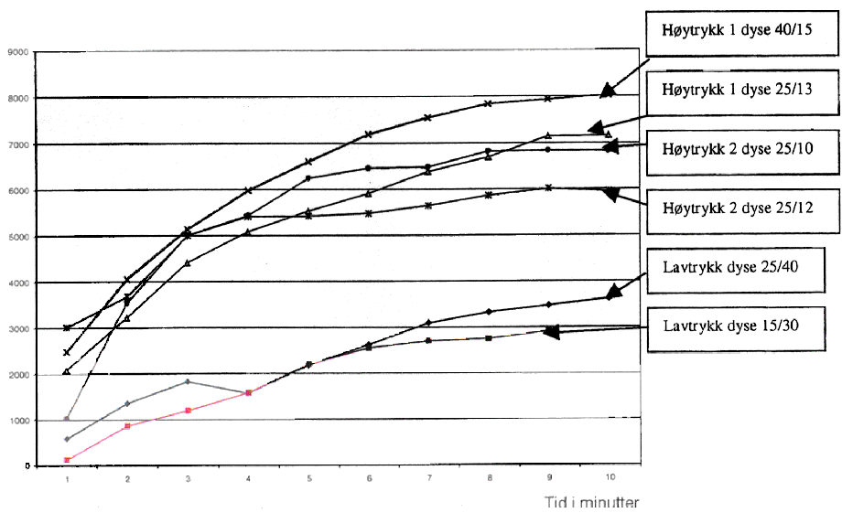
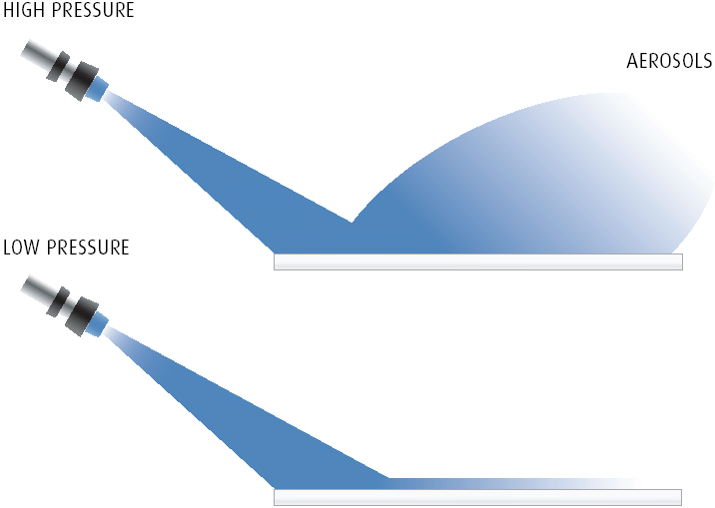
Aerosols
Number of 1000 particles
High pressure 1
High pressure 1
High pressure 2
High pressure 2
Low pressure
Low pressure
Time in minutes
High water pressure created much more aerosols, which can transport bacteria and spores.

Slide 25
Boosted pressure - not high pressure

Slide 26
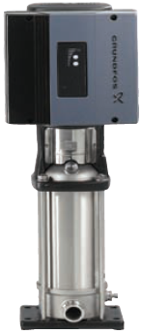
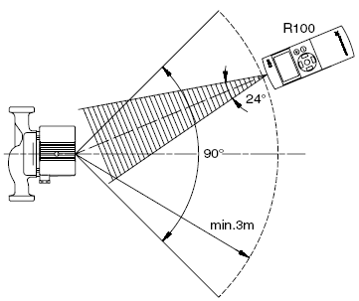
E-Motor Technology
  Right pressure when and where you need it
  Consistent concentration of chemical

Slide 27
Repetition…
Repetitive tasks are difficult, even in a perfect environment.
Plant environment is rarely an “ideal” environment.

Slide 28


Slide 29
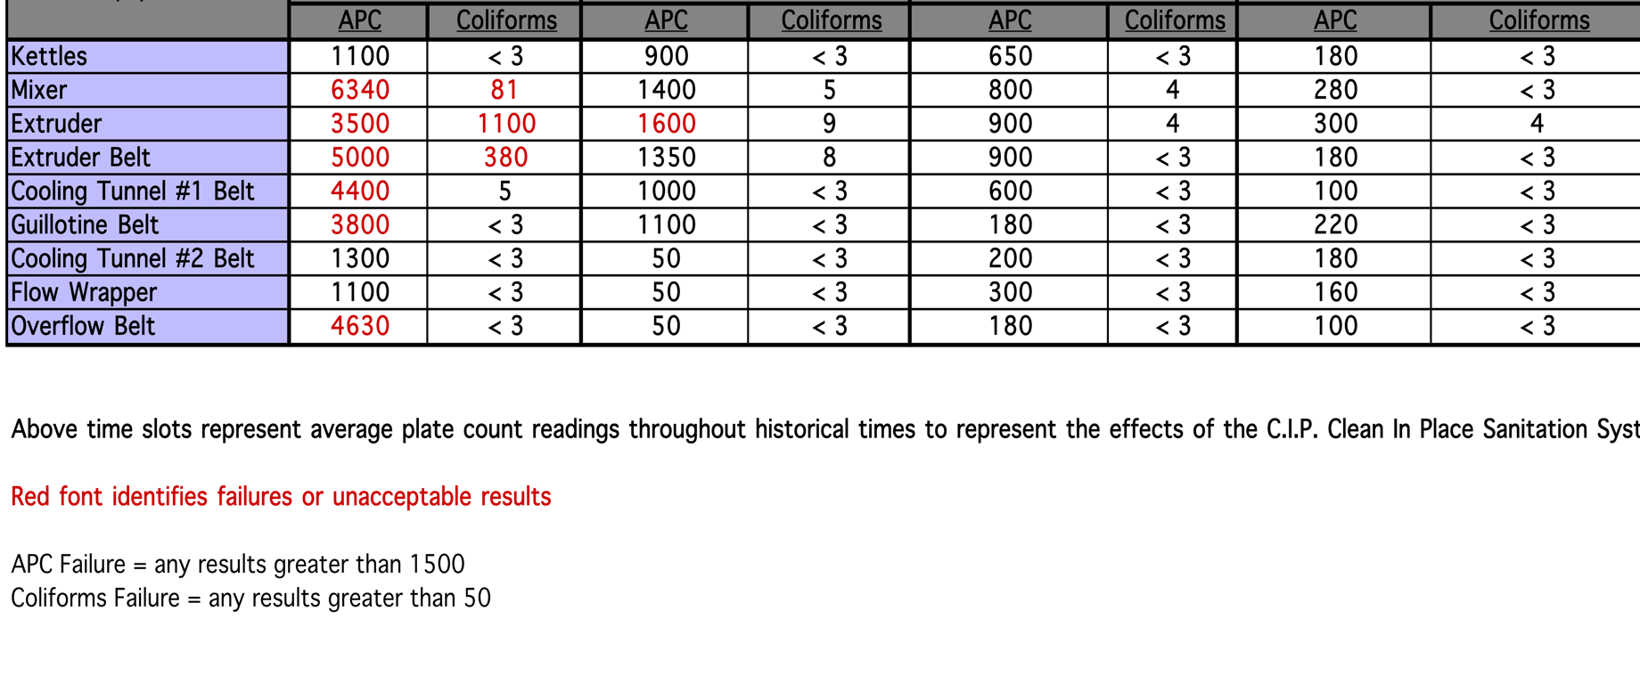
RTE Plant belt cleaning project

Slide 30
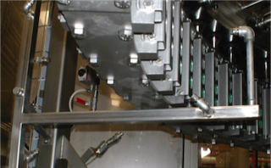
Even nozzle design makes a difference

Slide 31
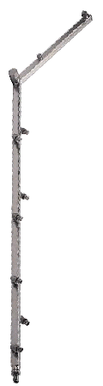
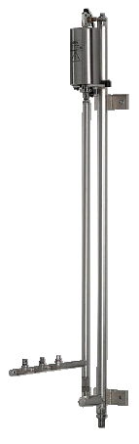
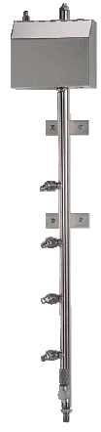
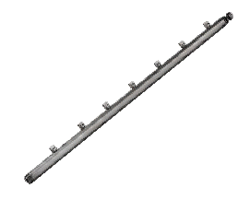
Collaborative approach

Slide 32
Sustainability
Electricity
Chemical use
Water

Slide 33
Sustainability through electrical savings
Multi stage pumps allow for full alternation
E-Motor allows for pump to ramp up and down as needed
Flow switch indicating no flow sends pump into “hibernate” mode

Slide 34
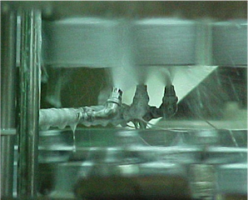
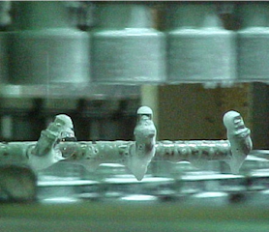
Sustainability through reduced chemical use
Chemical is dispensed
  where it is needed
  at the proper concentration
  without over spray

Slide 35

Sustainability by reducing water consumption

Slide 36
Adding up the cost of water
900 psi each nozzle emits 3.6 GPM
290 psi each nozzle emits 2.1 GPM
100 conveyors with an average of 10 nozzles each
1000 x 3.6 = 3,600
1000 x 2.1 = 2,100

Slide 37
Adding up the cost of water
3,600 x 7 (minute rinse cycle) = 25,200 Gallons of water
2100 x 7 (minute rinses cycle) = 14,700
In seven minutes this plant lost 10,500 gallons of water.
250 days a year = 2,625,000 gallons

Slide 38
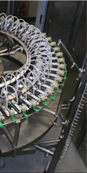
When considering automation:
  Must know current metrics
    Risk factors
    Electrical specs/current costs
    Water- volume, heat and treat
    Sanitation issues- pinch points
    Labor costs
    Layout of the facility- audit everything
Then, cast a wide net!

Slide 39
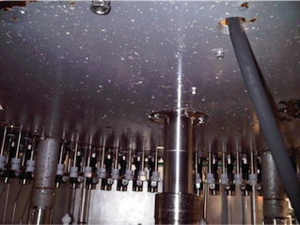
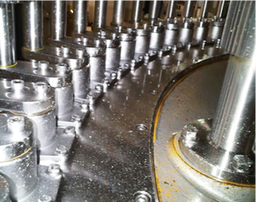
Adding up savings
Mitigate risk + Capture additional uptime + Repeatability + Sustainability =
Profit

